Slide 1

Heart Art
Jim Dine’s Pop Art
Learning Pop Art

Slide 2
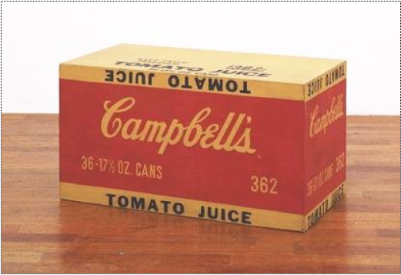
Pop Art – What is it?
Pop art started in Britain and America
Pop art uses everyday objects in art
Andy Warhol’s art: Paint and silk screen ink on wood

Slide 3
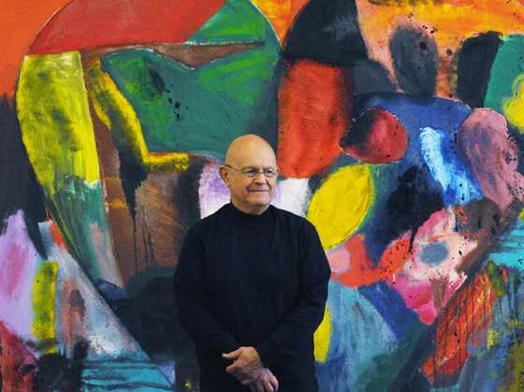
Who is Jim Dine?
American Pop Artist
Born in 1935 in Cincinnati, OH
Painter/Sculptor/Poet
Most famous for his paintings of hearts

Slide 4
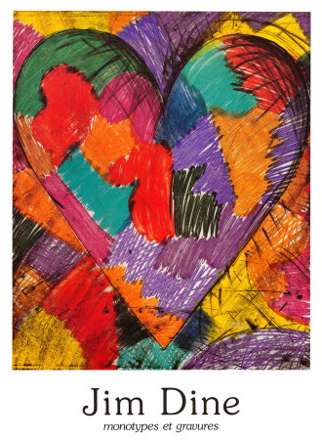
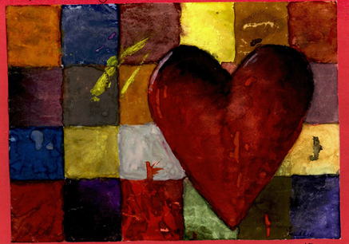
Bright colors used in Jim Dine’s paintings

Slide 5
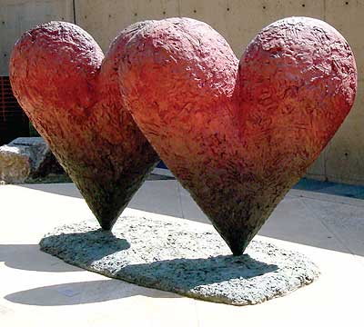
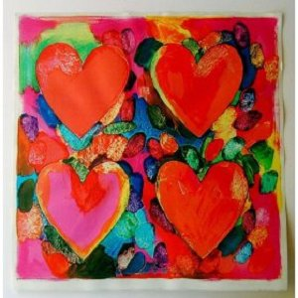
Heart sculpture and painting by Jim Dine

Slide 6
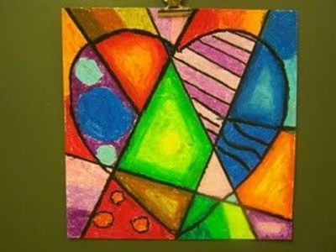
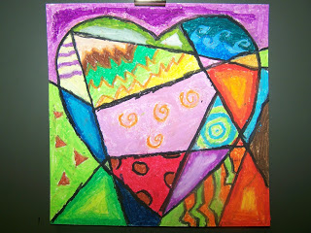
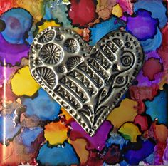

Slide 7
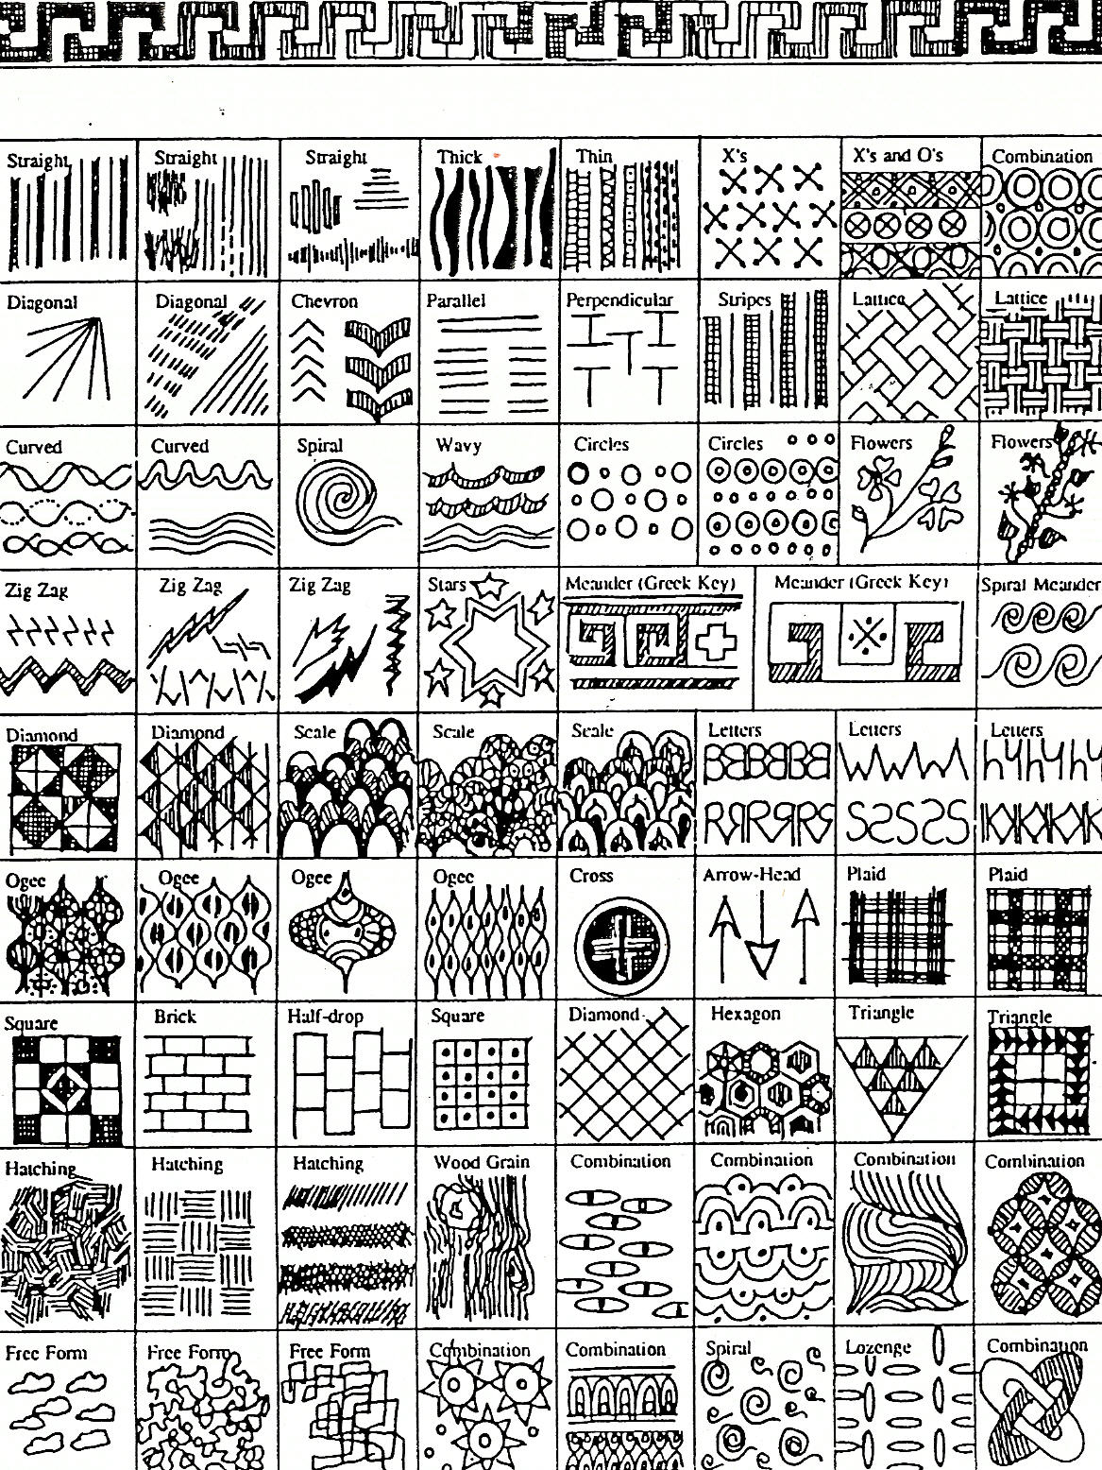
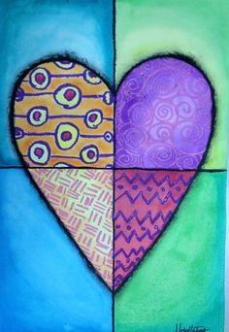
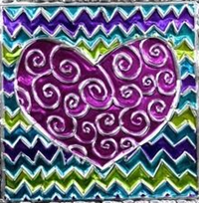
Lines and Patterns
Notes:
Examples of lines and patterns you can use

Slide 8
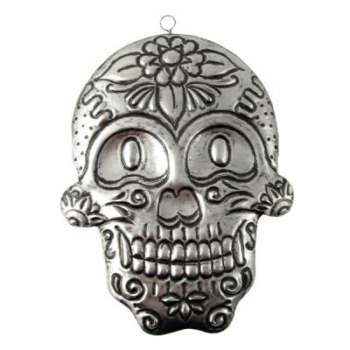
Metal tooling is a centuries-old art in
which a soft metal is worked with a
rounded tool on the back side in order to create a raised design on the front.
Mexican and South American artists call this art form repujado (Spanish), and it is also referred to as repoussé (in French) or embossing.
Element of Art
Line: A continuous path of a moving point through space which can very in width, direction, length, curvature, texture and color.
Notes:
Repujar = to emboss

Slide 9
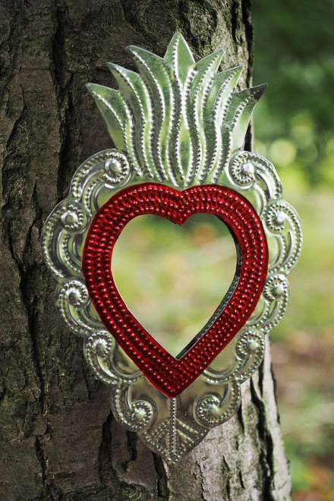
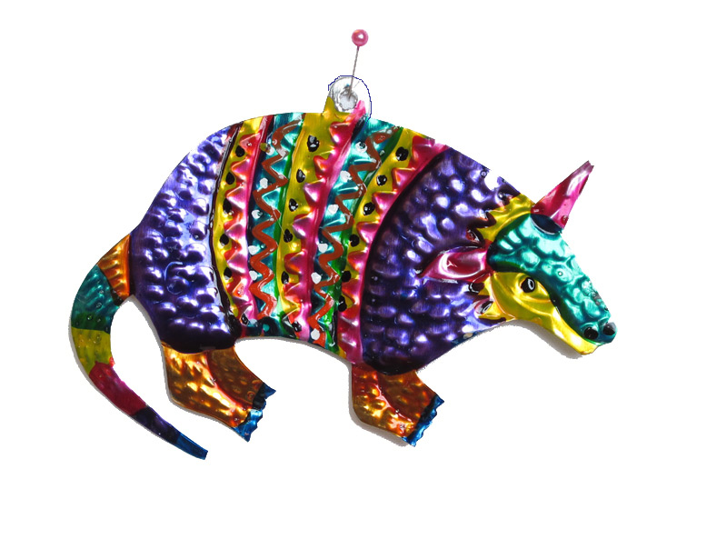
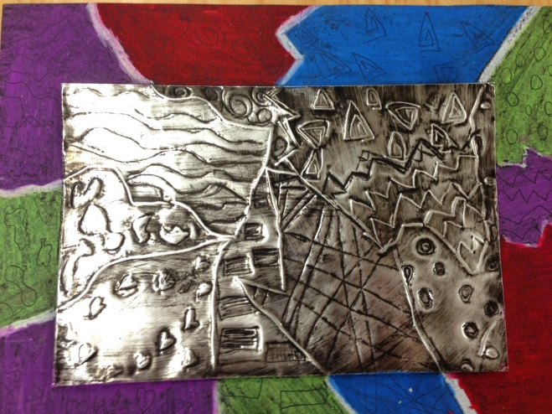
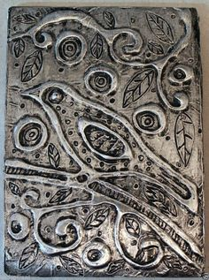
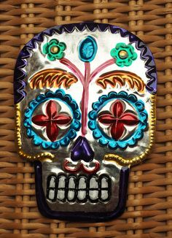
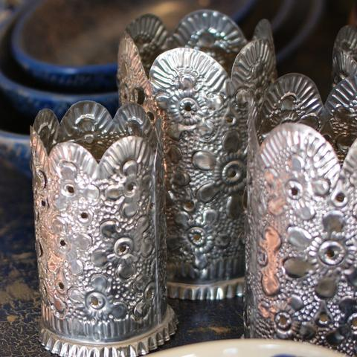
Examples of Metal Tooling on tin made in Mexico
Notes:
Examples of hojalata (Mexican metal tooling)
Tin work, known in Mexico as hojalata, goes back to the 16th Century. Artists use natural, oxidized and brightly laquered paints to create ornaments, mirrors, lanterns and other decorative pieces. San Miguel de Allende (about 160 miles north of Mexico City) and Oaxaca (about 225 miles south of Mexico City ) are areas in Mexico known for their beautiful tin work.

Slide 10
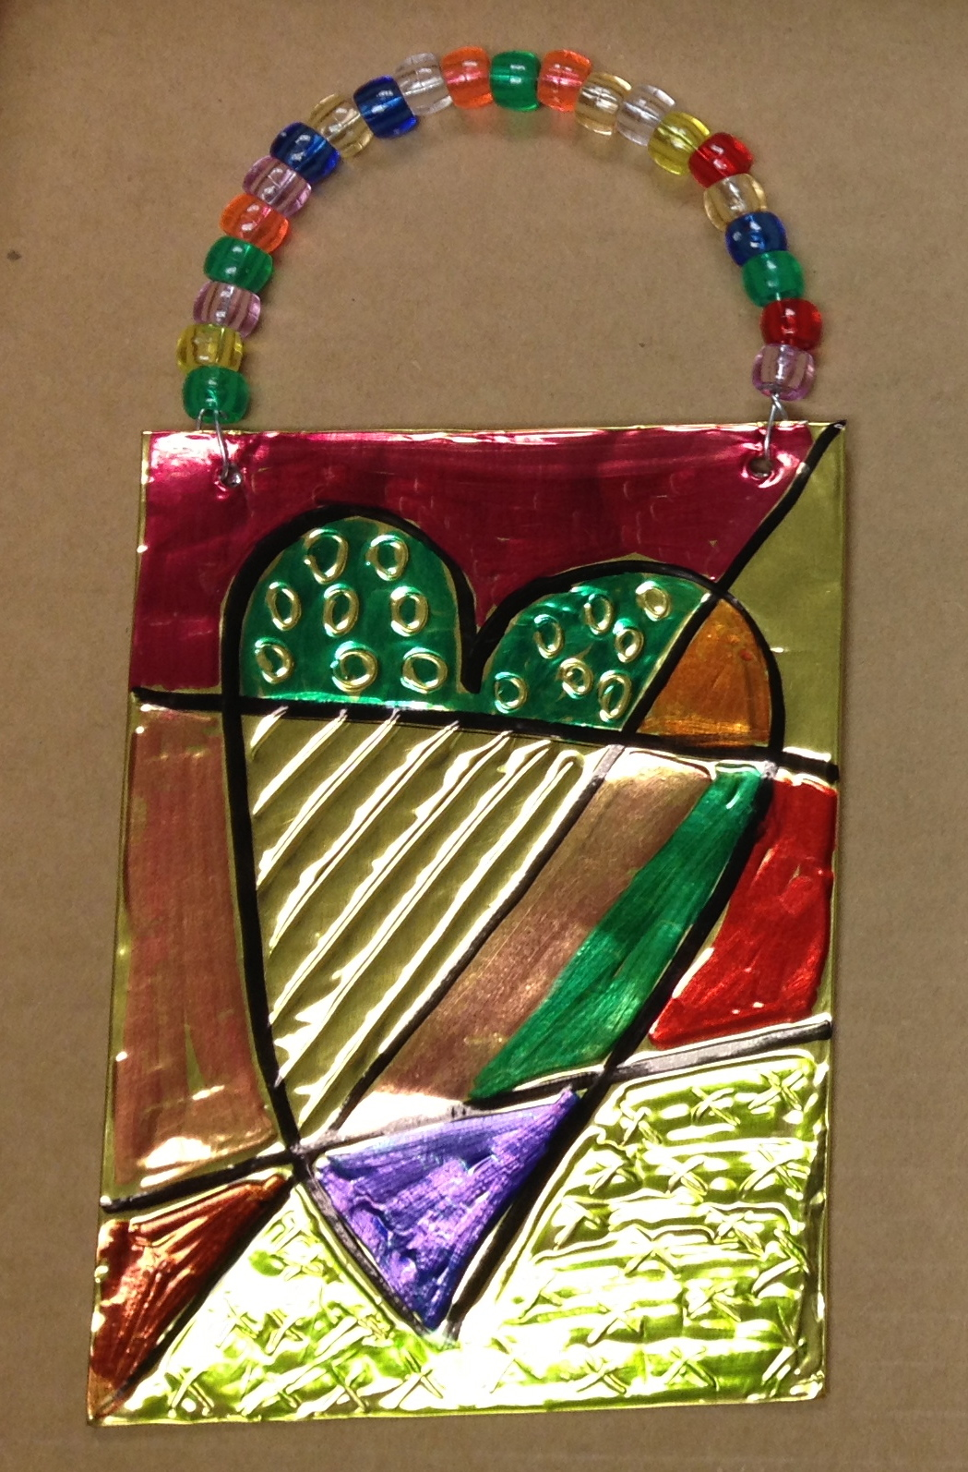
Today’s project
Notes:
Supplies
Tin wrapped around posterboard
Sharpie markers(colored)
Dull pencils
Wire or pipe cleaners
Beads

Slide 11
Docent Preparation Steps:
1. Cut mat board to 6”x 3.75” rectangles, and metal sheet 4”x 6.5” long (4” metal roll). Wrap metal sheet around mat board.
2. Punch 2 holes on top for pipe cleaner hanger.
3. Prepare your class box with the above metal wrapped mats with holes punched, pipe cleaners, beads, dull pencils, black sharpies, and colored sharpies.

Slide 12
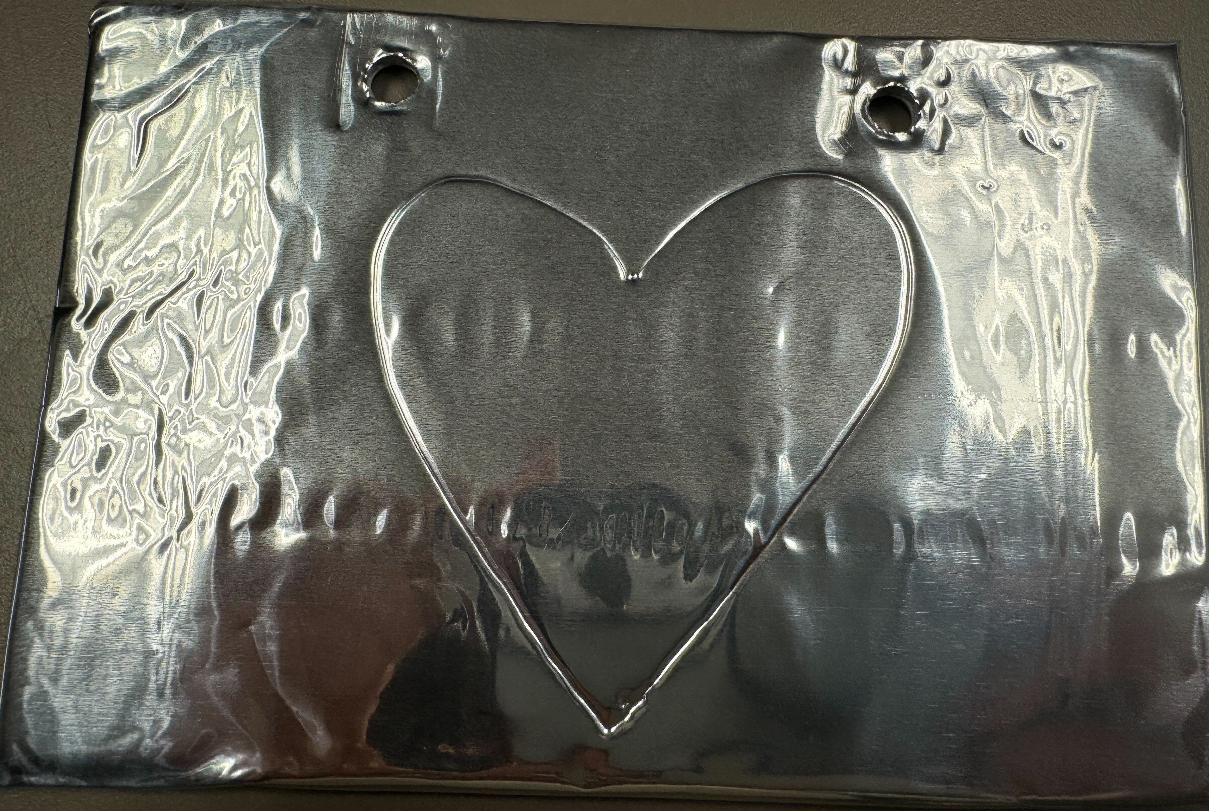
Instructions
Start will adding your name on the back using a sharpie
Using a dull pencil, draw one large heart filing the sheet as best you can.

Slide 13
Instructions
  3. Divide heart and page into sections. Draw lines through the heart vertical, horizontal, and then diagonal.
  4. Use your black sharpie to trace over your lines.

Slide 14
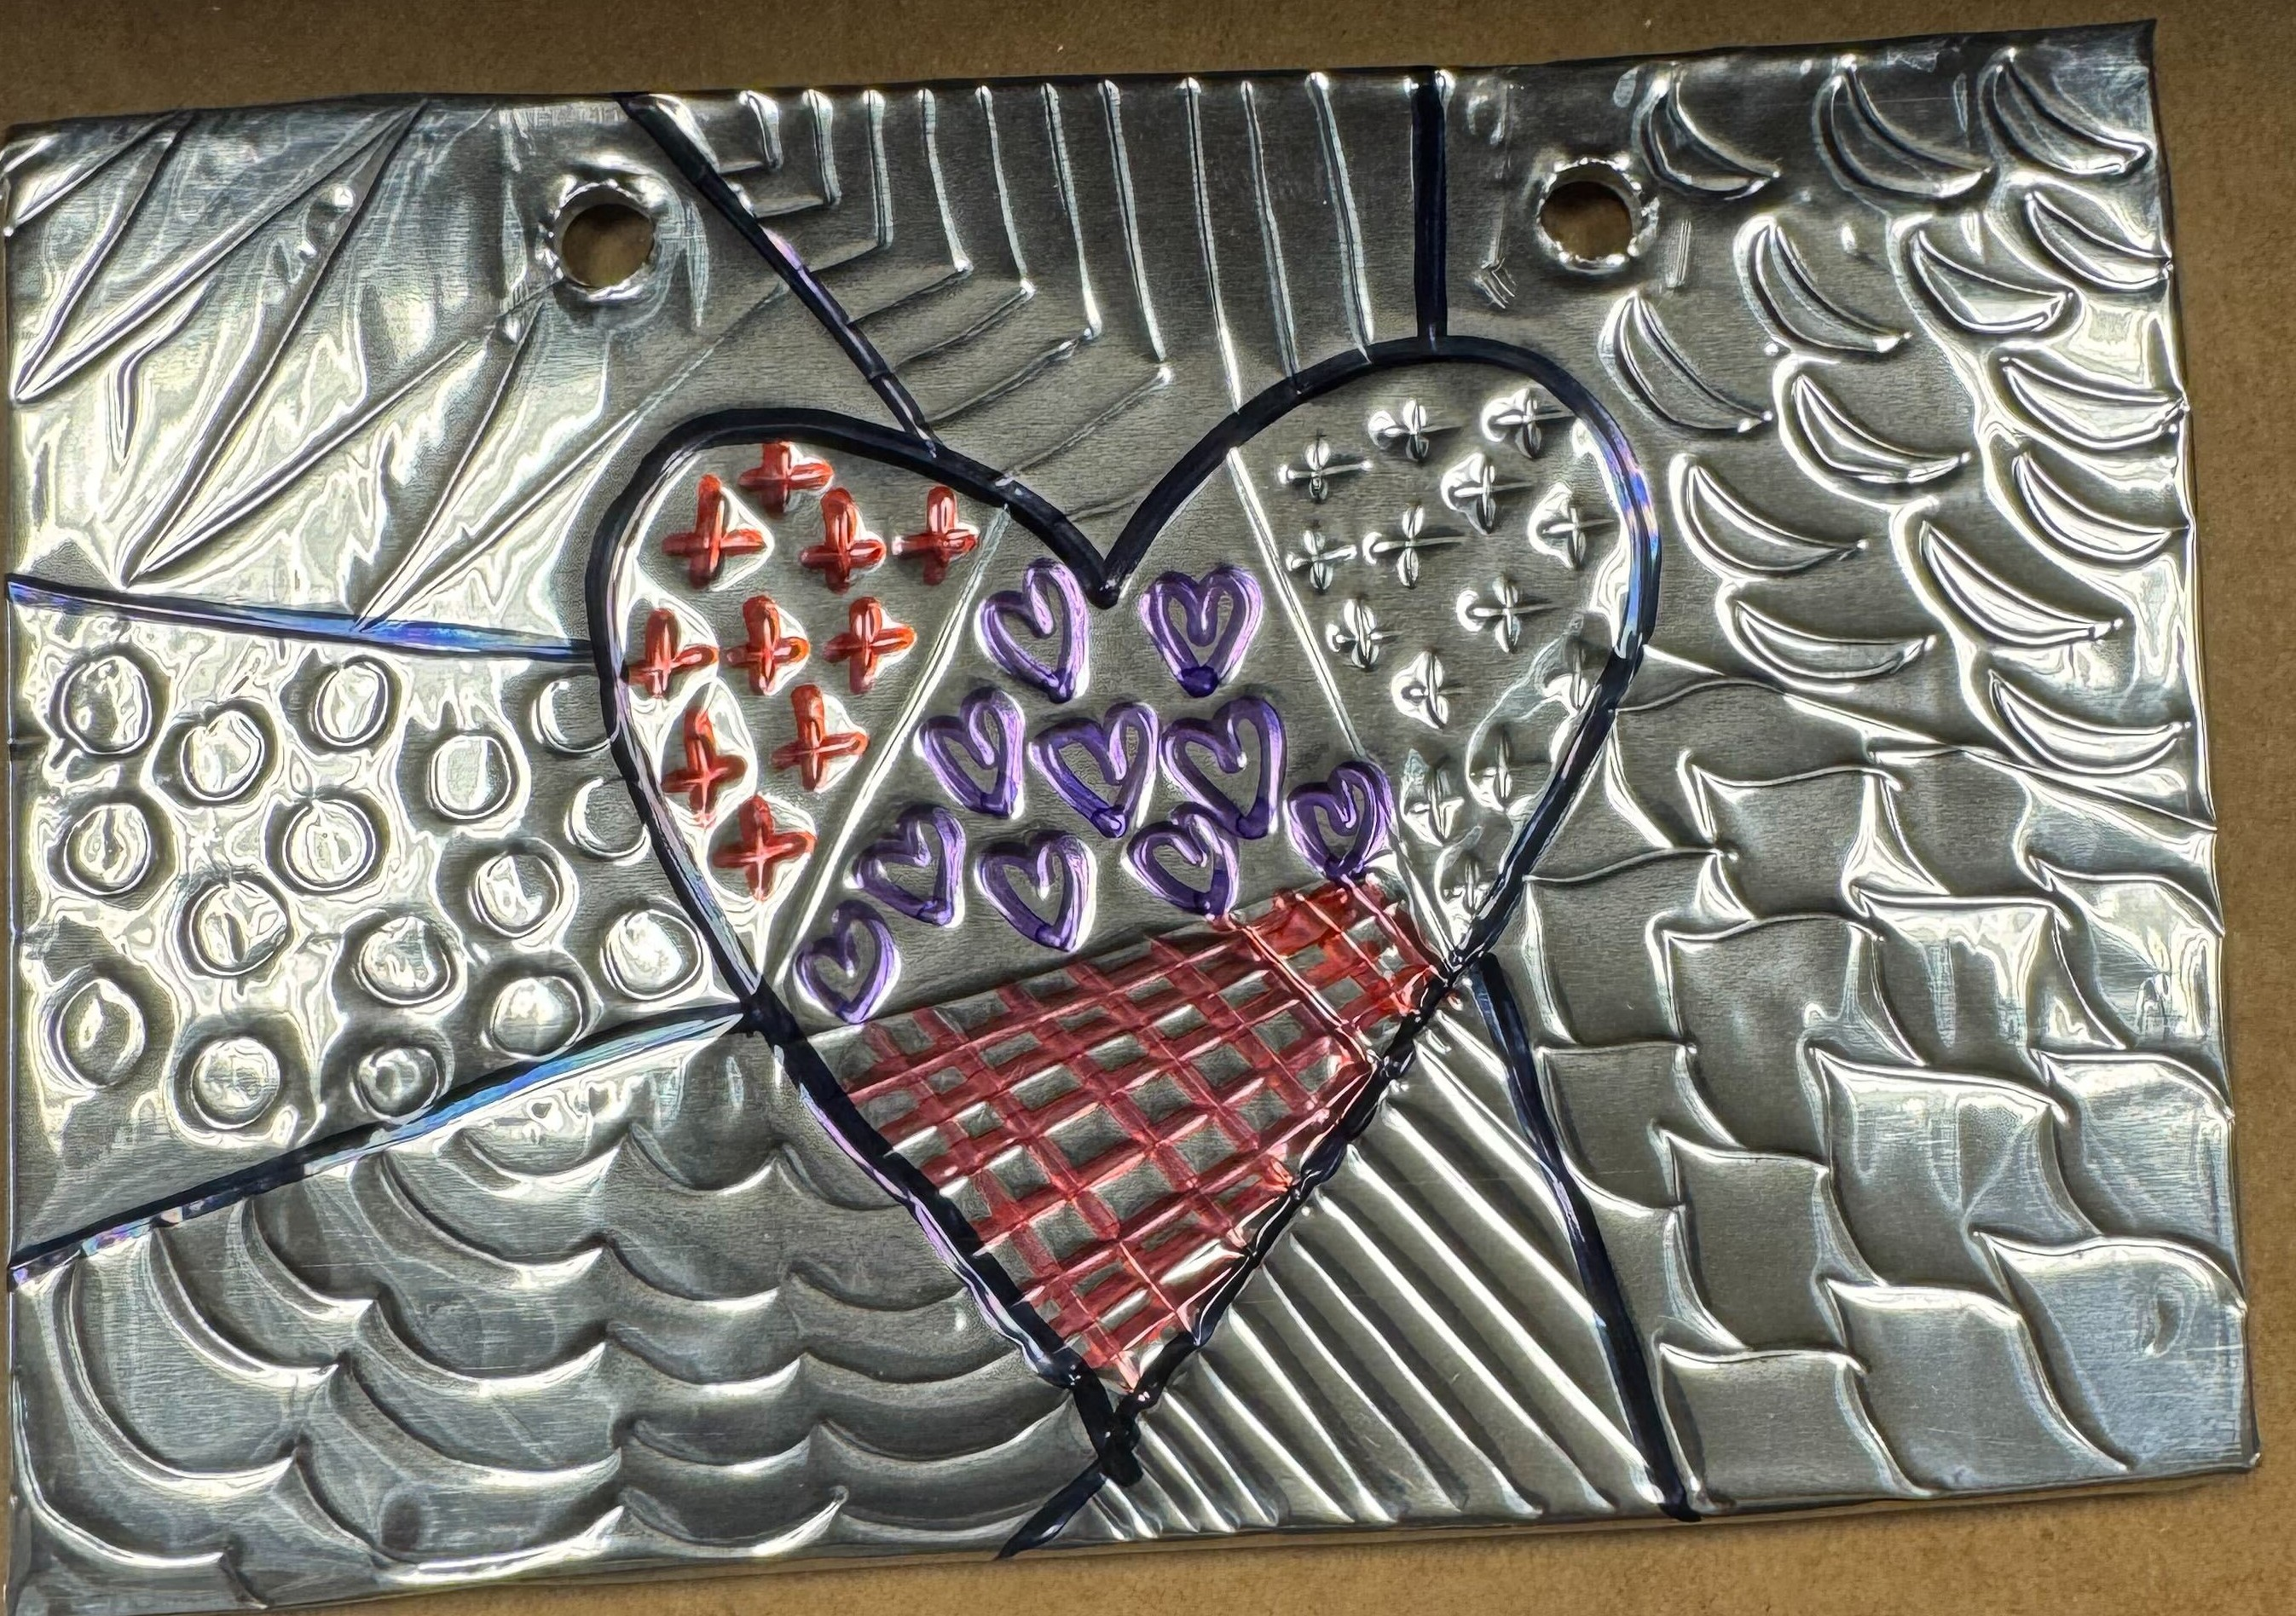
Instructions
5. Using your dull pencil, add patterns into each section of your heart and page

Slide 15
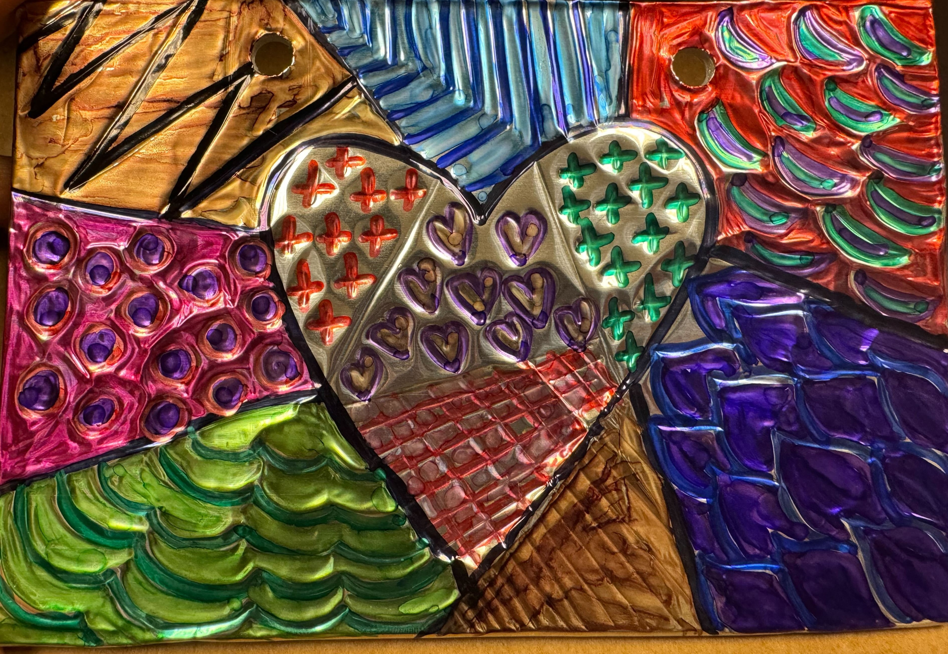
Instructions
6. Color in each section with a different colored sharpie marker. You can either outline with different colors or fill the pattern with colors

Slide 16
Instructions
7. Thread your pipe cleaner into one hole. Twist the end to make it stay put.
8. Now Add beads to make pattern or single color
9. Thread the other end into the second hole. Twist the wire end to make the hanger and beads stay put.

Slide 17
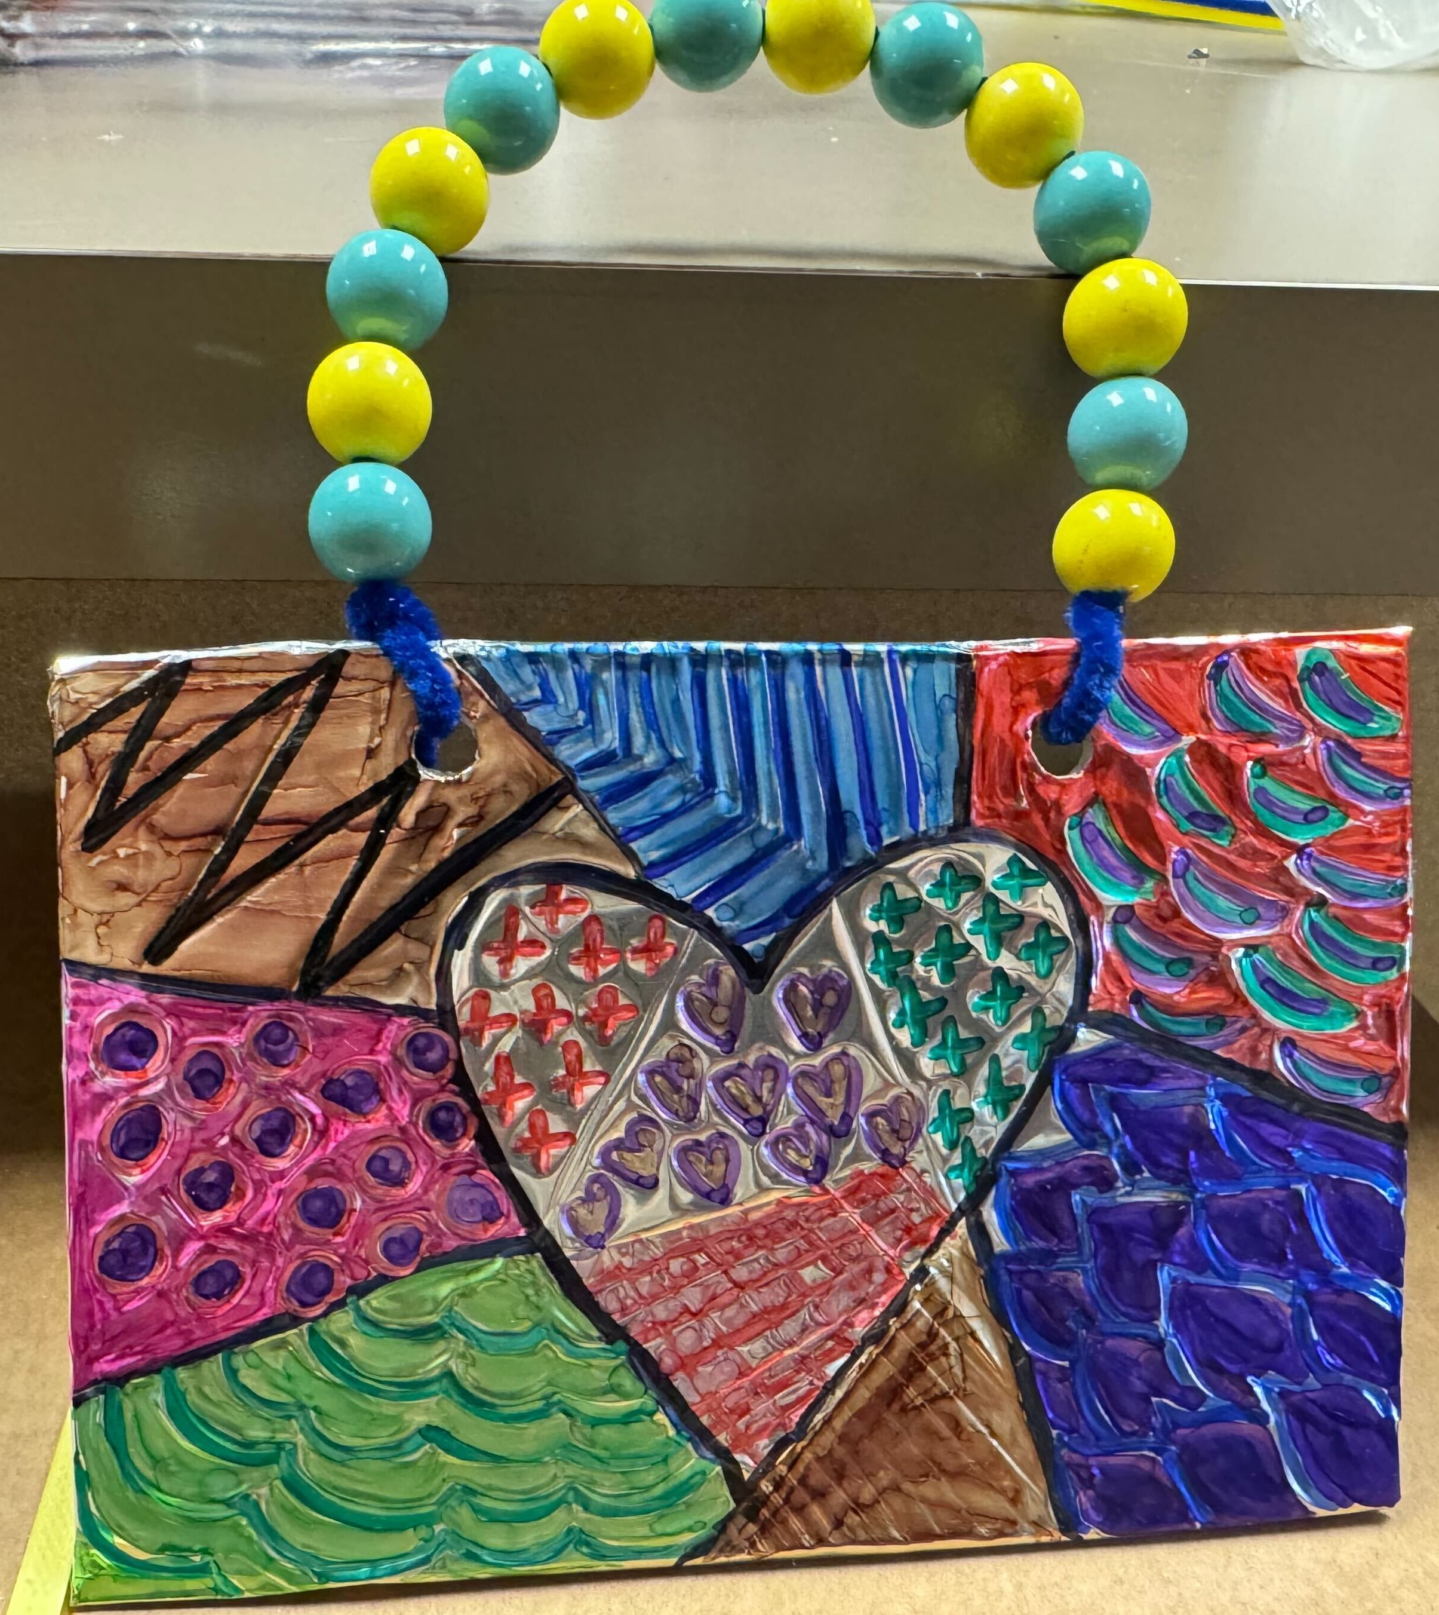
Final project

